Slide 1
跟着Kevin学英语(9)
Daddy Loses his Glasses

Slide 2
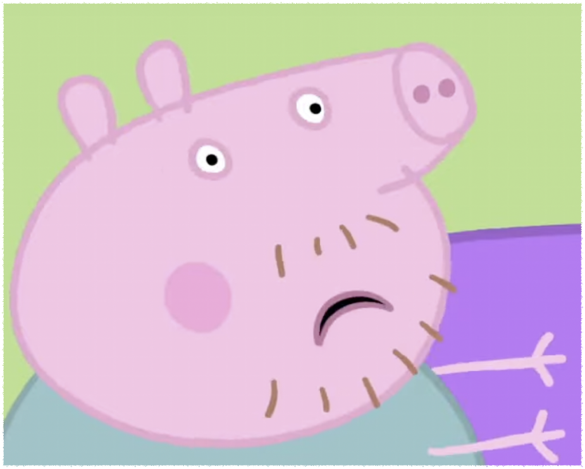
L s
Lose
Notes:
Daddy loses his glasses

Slide 3
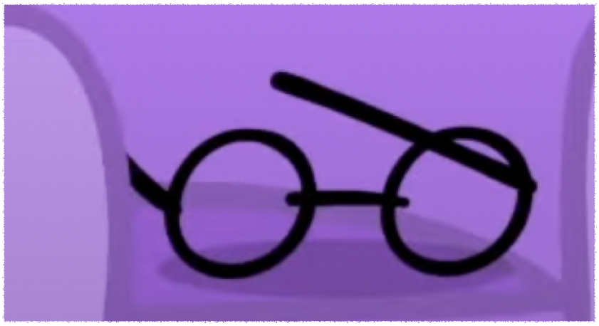
G g
Glasses
Notes:
Daddy loses his glasses

Slide 4

F f
Fish
Fuzzy
Notes:
This is a yellow fish

Slide 5

F f
Fish
Fuzzy
Notes:
Everything looks fuzzy

Slide 6
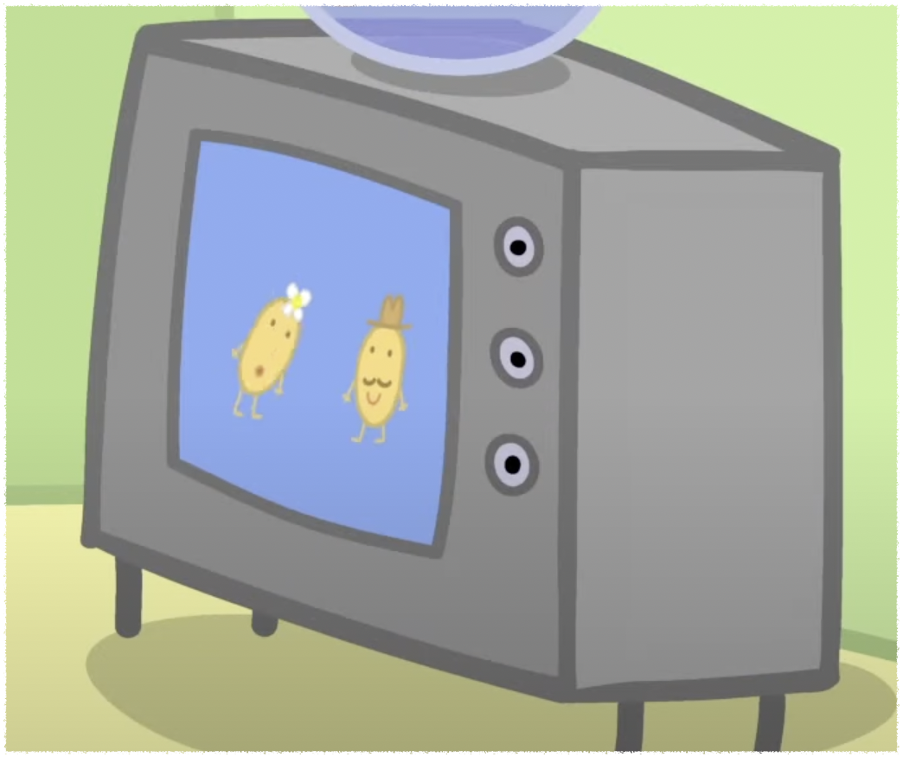
T t
Television(TV)
Notes:
I like watching TV

Slide 7

P p
Pillow
Notes:
There are two pillows on the bed

Slide 8
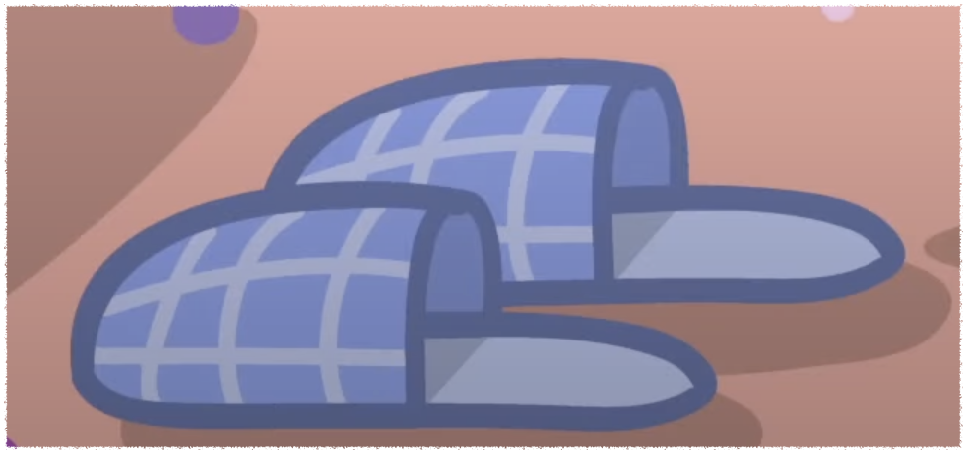
S s
Slipper
Notes:
There is a pair of slippers

Slide 9
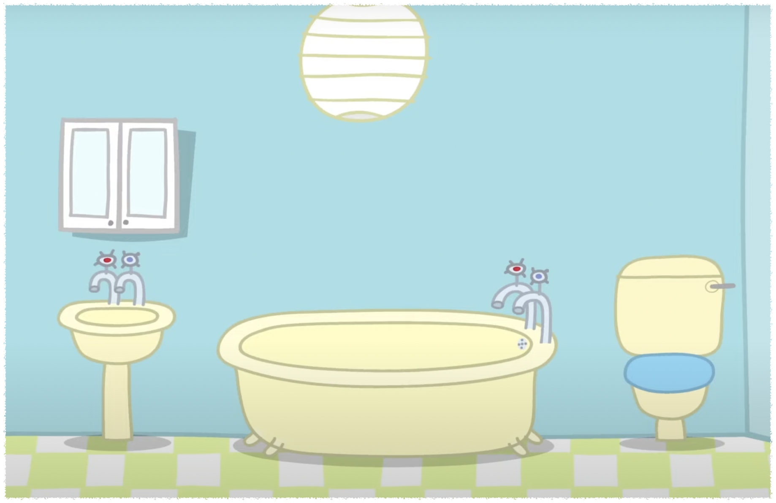
B b
Bathroom
Notes:
Let’s look in the bathroom

Slide 10
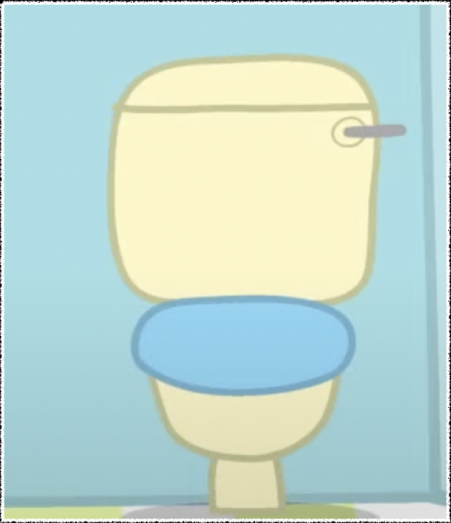
T t
Toilet
Notes:
The glasses are not in the toilet

Slide 11
He can’t find it anywhere
Be careful
It’s not funny
It’s too difficult

